Slide 1

6th Grade Math
Unit 8, Lesson 7 Volume of Rectangular Prisms Volume 2, pg. 110

Slide 2


Benchmark
MA.6.GR.2.3
Solve mathematical and real-world problems involving the volume of right rectangular prisms with positive rational number edge lengths using a visual model and a formula.
volume 2, pg. 110

Slide 3
Integrated Mathematical Thinking and Reasoning Standards
MA.K12.MTR.1.1 Actively participate in effortful learning both individually and collectively.
MA.K12.MTR.2.1 Demonstrate understanding by representing problems in multiple ways.
MA.K12.MTR.3.1 Complete tasks with mathematical fluency.
MA.K12.MTR.4.1 Engage in discussions that reflect on the mathematical thinking of self and others.
MA.K12.MTR.5.1 Use patterns and structure to help understand and connect mathematical concepts.
MA.K12.MTR.6.1 Assess the reasonableness of solutions.
volume 2, pg. 110

Slide 4

Learning Target
I can find the volume of a rectangular prism.
volume 2, pg. 110

Slide 5

Warm-Up
volume 2, pg. 111

Slide 6
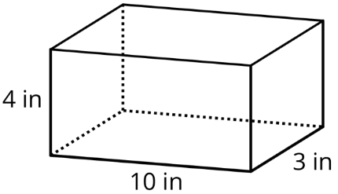
8.7.1 Warm-Up: A Box of Cubes
How many cubes with an edge length of $1$ inch (in.) fill the box?
volume 2, pg. 111

Slide 7

If the cubes had an edge length of $2$ inches, explain if more or fewer cubes would be needed to fill the box.
If the cubes had an edge length of $\frac{1}{2}$ inch, explain if more or fewer cubes would be needed to fill the box.
volume 2, pg. 111

Slide 8

Guided Instruction
volume 2, pg. 111

Slide 9
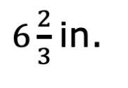
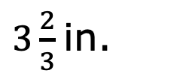
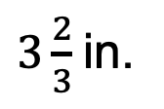
8.7.2 Guided Instruction: Two Methods for Finding the Volume of a Right Rectangular Prism
Alan calculated the volume of the rectangular prism.
volume 2, pg. 111

Slide 10
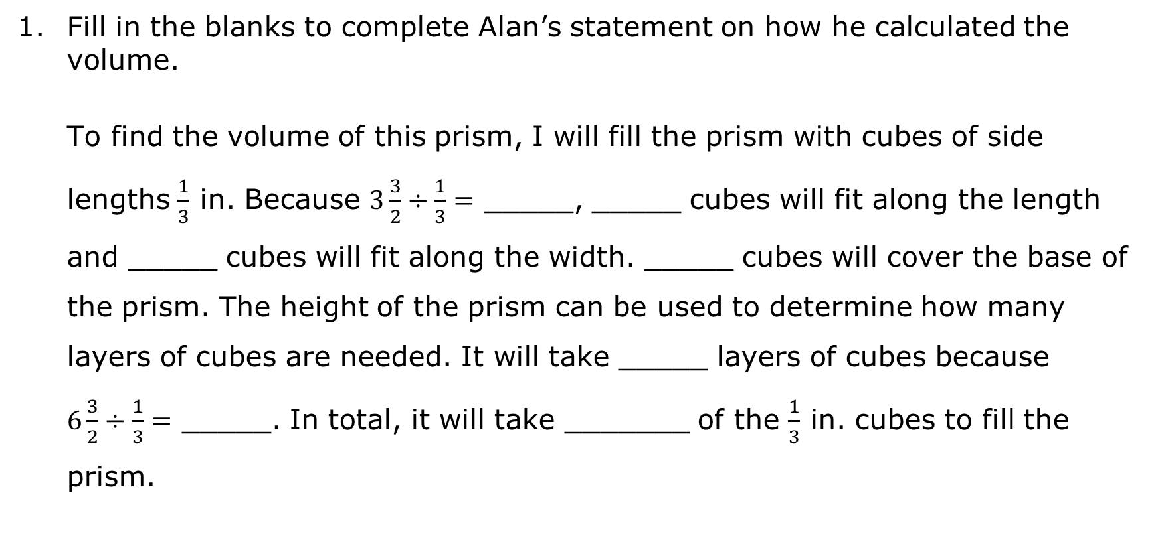
Fill in the blanks to complete Alan’s statement on how he calculated the volume.
To find the volume of this prism, I will fill the prism with cubes of side lengths $\frac{1}{3}$ in. Because $3\frac{3}{2}÷\frac{1}{3}=$ _____, _____ cubes will fit along the length and _____ cubes will fit along the width. _____ cubes will cover the base of the prism. The height of the prism can be used to determine how many layers of cubes are needed. It will take _____ layers of cubes because $6\frac{3}{2}÷\frac{1}{3}=$ _____. In total, it will take _______ of the $\frac{1}{3}$ in. cubes to fill the prism.
volume 2, pg. 111

Slide 11
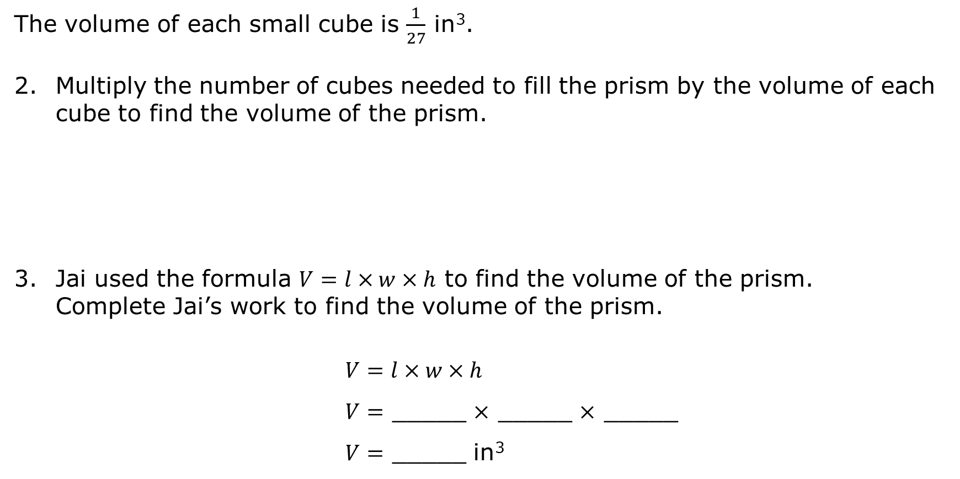
The volume of each small cube is $\frac{1}{27}$ in³.
Multiply the number of cubes needed to fill the prism by the volume of each cube to find the volume of the prism.
Jai used the formula $V=l×w×h$ to find the volume of the prism. Complete Jai’s work to find the volume of the prism.
$V=l×w×h$
$V=$ _____ $×$ _____ $×$ _____
$V=$ _____ in³
volume 2, pg. 112

Slide 12


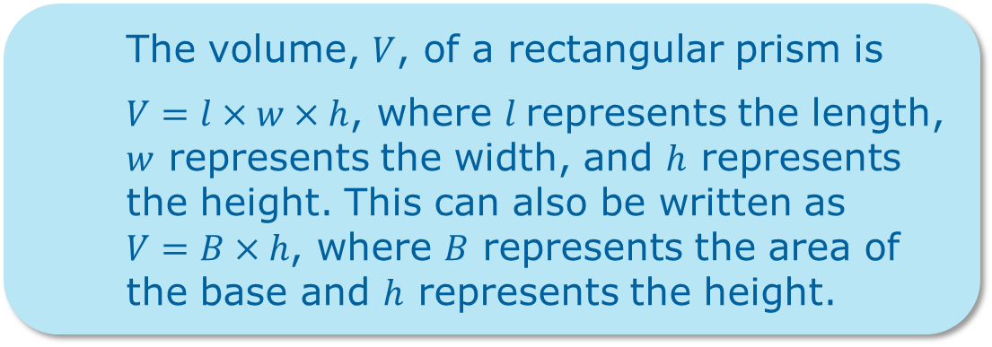
How are Alan and Jai’s methods similar?
Discuss with your partner how the formula $V=B∙h$ is related to the formula $V=l∙w∙h$.
The volume, $V$, of a rectangular prism is
$V=l×w×h$, where $l$represents the length, $w$ represents the width, and $h$ represents the height. This can also be written as $V=B×h$, where $B$ represents the area of the base and $h$ represents the height.
volume 2, pg. 112

Slide 13
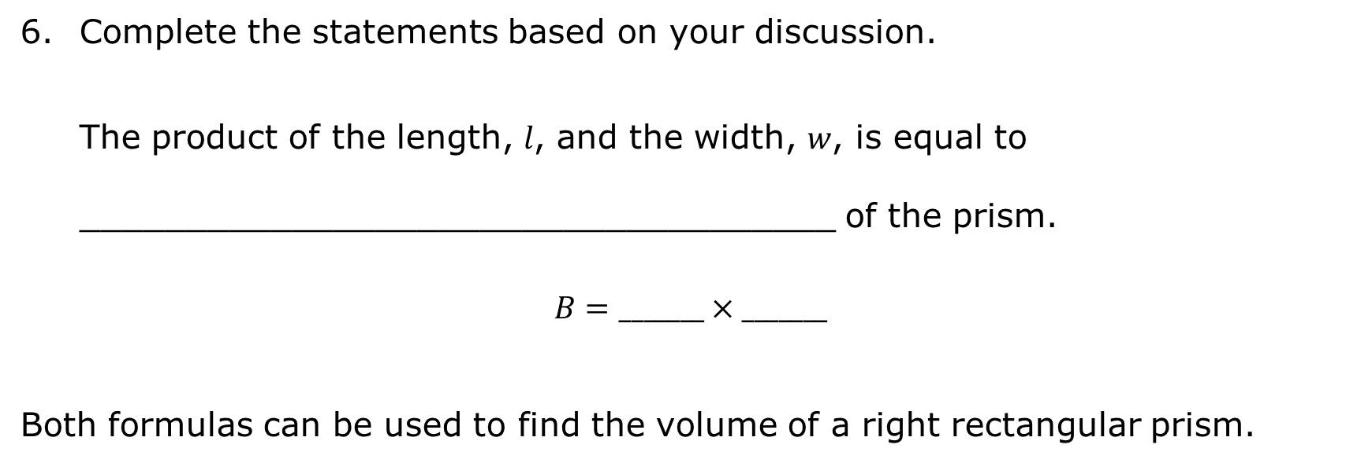
Complete the statements based on your discussion.
The product of the length, $l$, and the width, $w$, is equal to ____________________________________ of the prism.
$$B=_______×_______$$
Both formulas can be used to find the volume of a right rectangular prism.
volume 2, pg. 112

Slide 14

Guided Practice
volume 2, pg. 113

Slide 15

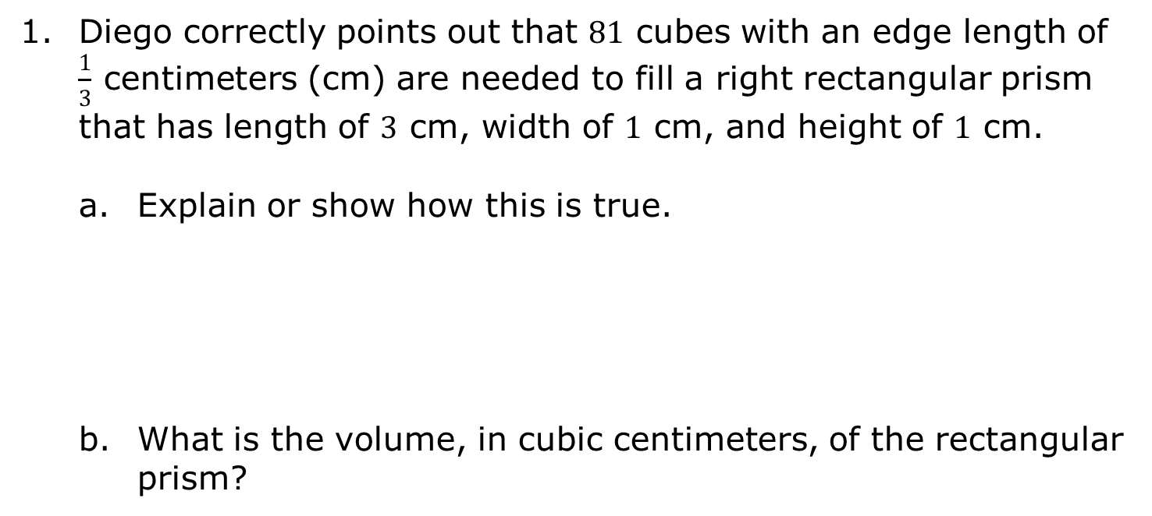
8.7.3 Guided Practice: Volume of a Right Rectangular Prism
Diego correctly points out that $81$ cubes with an edge length of $\frac{1}{3}$ centimeters (cm) are needed to fill a right rectangular prism that has length of $3$ cm, width of $1$ cm, and height of $1$ cm.
Explain or show how this is true.
What is the volume, in cubic centimeters, of the rectangular prism?
volume 2, pg. 113

Slide 16
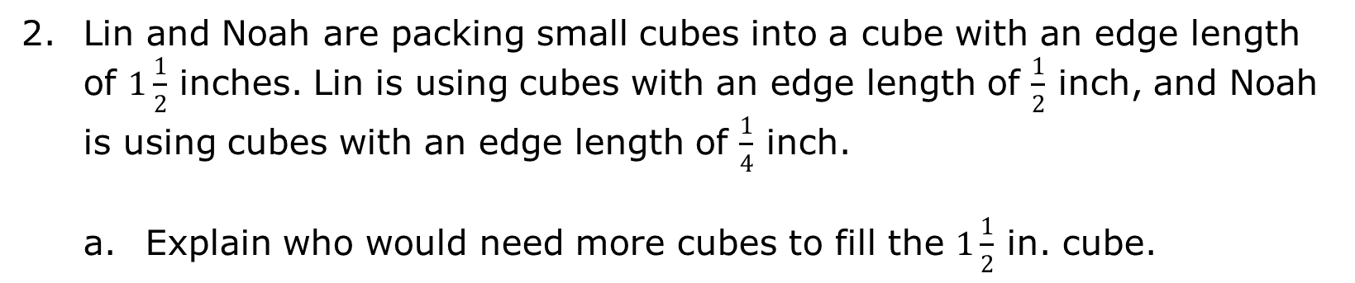
Lin and Noah are packing small cubes into a cube with an edge length of $1\frac{1}{2}$ inches. Lin is using cubes with an edge length of $\frac{1}{2}$ inch, and Noah is using cubes with an edge length of $\frac{1}{4}$ inch.
Explain who would need more cubes to fill the $1\frac{1}{2}$ in. cube.
volume 2, pg. 113

Slide 17

Explain whether Lin and Noah will find the same volume of the $1\frac{1}{2}$ inch cube using their method.
What is the volume of the cube with $1\frac{1}{2}$ inch edge lengths? Include units.
volume 2, pg. 113

Slide 18
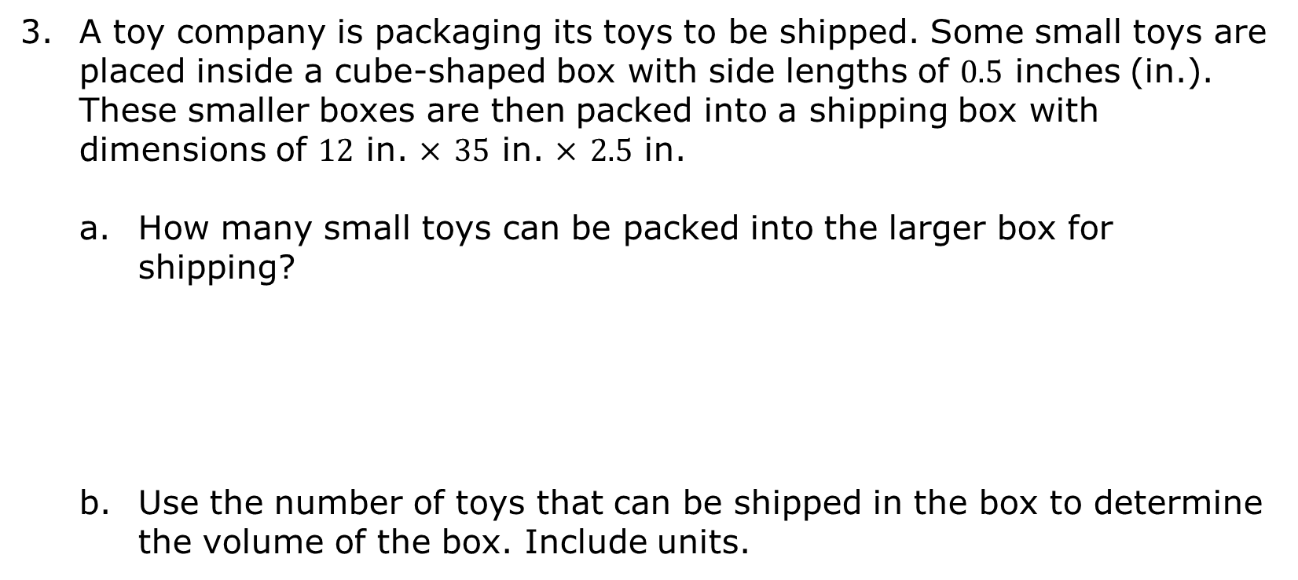
A toy company is packaging its toys to be shipped. Some small toys are placed inside a cube-shaped box with side lengths of $0.5$ inches (in.). These smaller boxes are then packed into a shipping box with dimensions of $12$ in. $×$ $35$ in. $×$ $2.5$ in.
How many small toys can be packed into the larger box for shipping?
Use the number of toys that can be shipped in the box to determine the volume of the box. Include units.
volume 2, pg. 113

Slide 19

Your Turn
volume 2, pg. 114

Slide 20
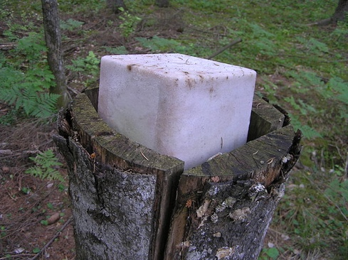
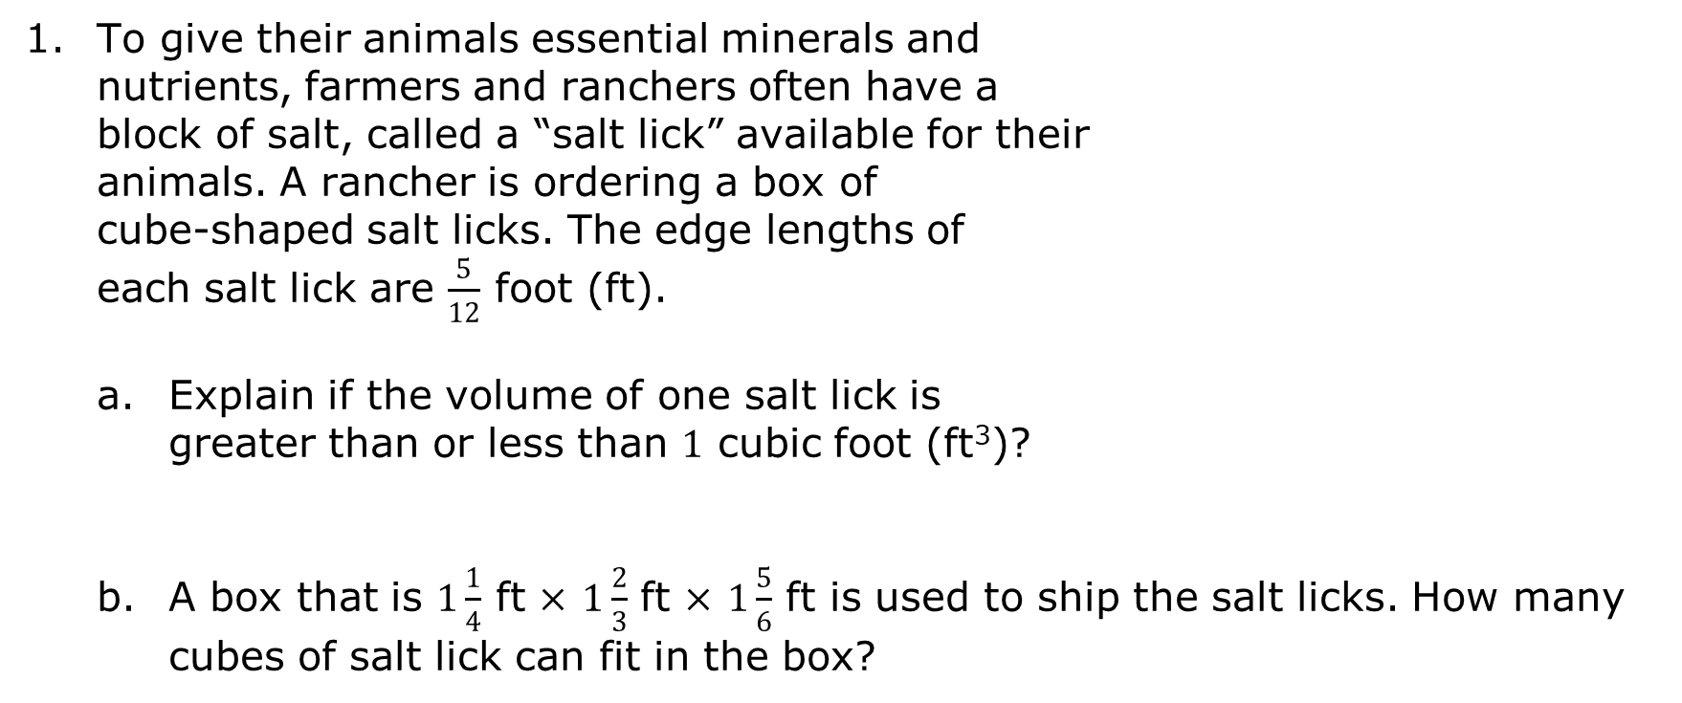
8.7.4 Your Turn!
To give their animals essential minerals and nutrients, farmers and ranchers often have a block of salt, called a “salt lick” available for their animals. A rancher is ordering a box of cube-shaped salt licks. The edge lengths of each salt lick are $\frac{5}{12}$ foot (ft).
Explain if the volume of one salt lick is greater than or less than $1$ cubic foot (ft³)?
A box that is $1\frac{1}{4}$ ft $×$ $1\frac{2}{3}$ ft $×$ $1\frac{5}{6}$ ft is used to ship the salt licks. How many cubes of salt lick can fit in the box?
volume 2, pg. 114

Slide 21
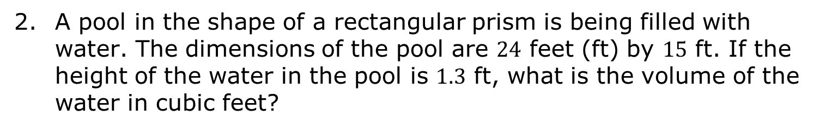
A pool in the shape of a rectangular prism is being filled with water. The dimensions of the pool are $24$ feet (ft) by $15$ ft. If the height of the water in the pool is $1.3$ ft, what is the volume of the water in cubic feet?
volume 2, pg. 114

Slide 22

Wrap-Up
volume 2, pg. 115

Slide 23
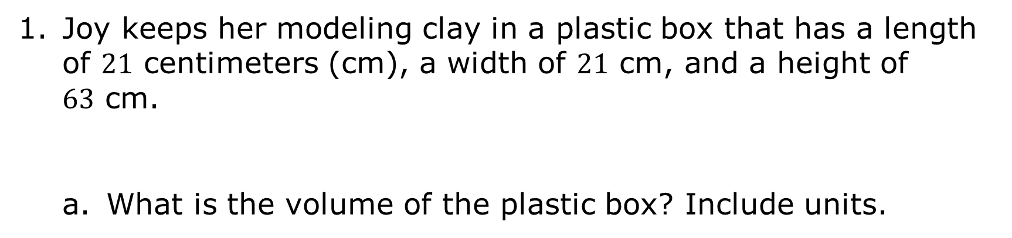
8.7.5 Wrap-Up: Ticket Out the Door
Joy keeps her modeling clay in a plastic box that has a length of $21$ centimeters (cm), a width of $21$ cm, and a height of $63$ cm.
What is the volume of the plastic box? Include units.
volume 2, pg. 115

Slide 24
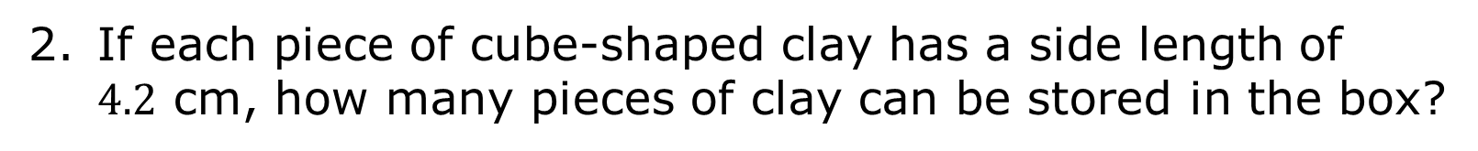
If each piece of cube-shaped clay has a side length of $4.2$ cm, how many pieces of clay can be stored in the box?
volume 2, pg. 115

